Slide 1
不确定数据管理
金澈清

Slide 2
大纲
应用背景和数据模型
不确定时空数据库
不确定数据集成
不确定数据世系管理
ranking查询
NN查询
Inversed NN
skyline

Slide 3
一、应用背景和数据模型

Slide 4
信息世界的不确定性
1. 原始数据不准确
4. 缺失值处理
2. 聚集数据集
应用背景
5. 数据集成
3. 隐私保护
6. 更多应用····

Slide 5

原始数据不精确
仪器精度
网络传输
外部环境影响
应用举例
传感器网络
RFID读卡器，读准率仅60%-70%

Slide 6
传感器网络的架构
服务
外部用户
因特网
本地用户
网关
传感器节点
网关
多跳低能耗的无线网络
传感器节点经由多跳无线网络（multi-hop wireless networks）连接
数据在传感器网络之中路由并且被获得
网关将传感器簇和有线网络/因特网连接起来
服务处理传感器簇中产生的数据，并向固定/移动外部用户提供信息
本地用户可以从无线网络中直接获取并处理数据
面向查询的处理模型

Slide 7
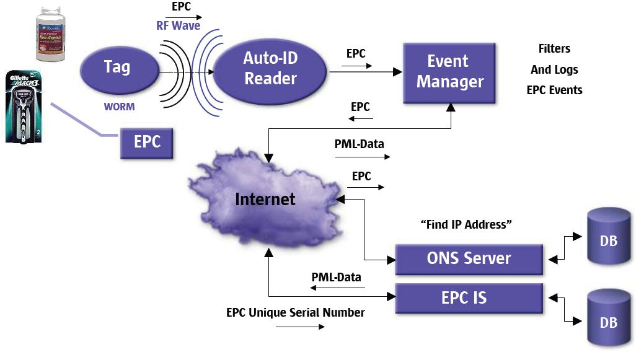
RFID应用
Source: Sun and RFID

Slide 8

聚集数据集
局部聚集
各条聚集记录可以被视为是服从一个概率分布
应用举例
人口数据集合

Slide 9
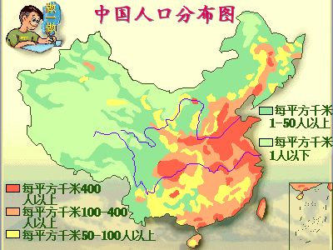
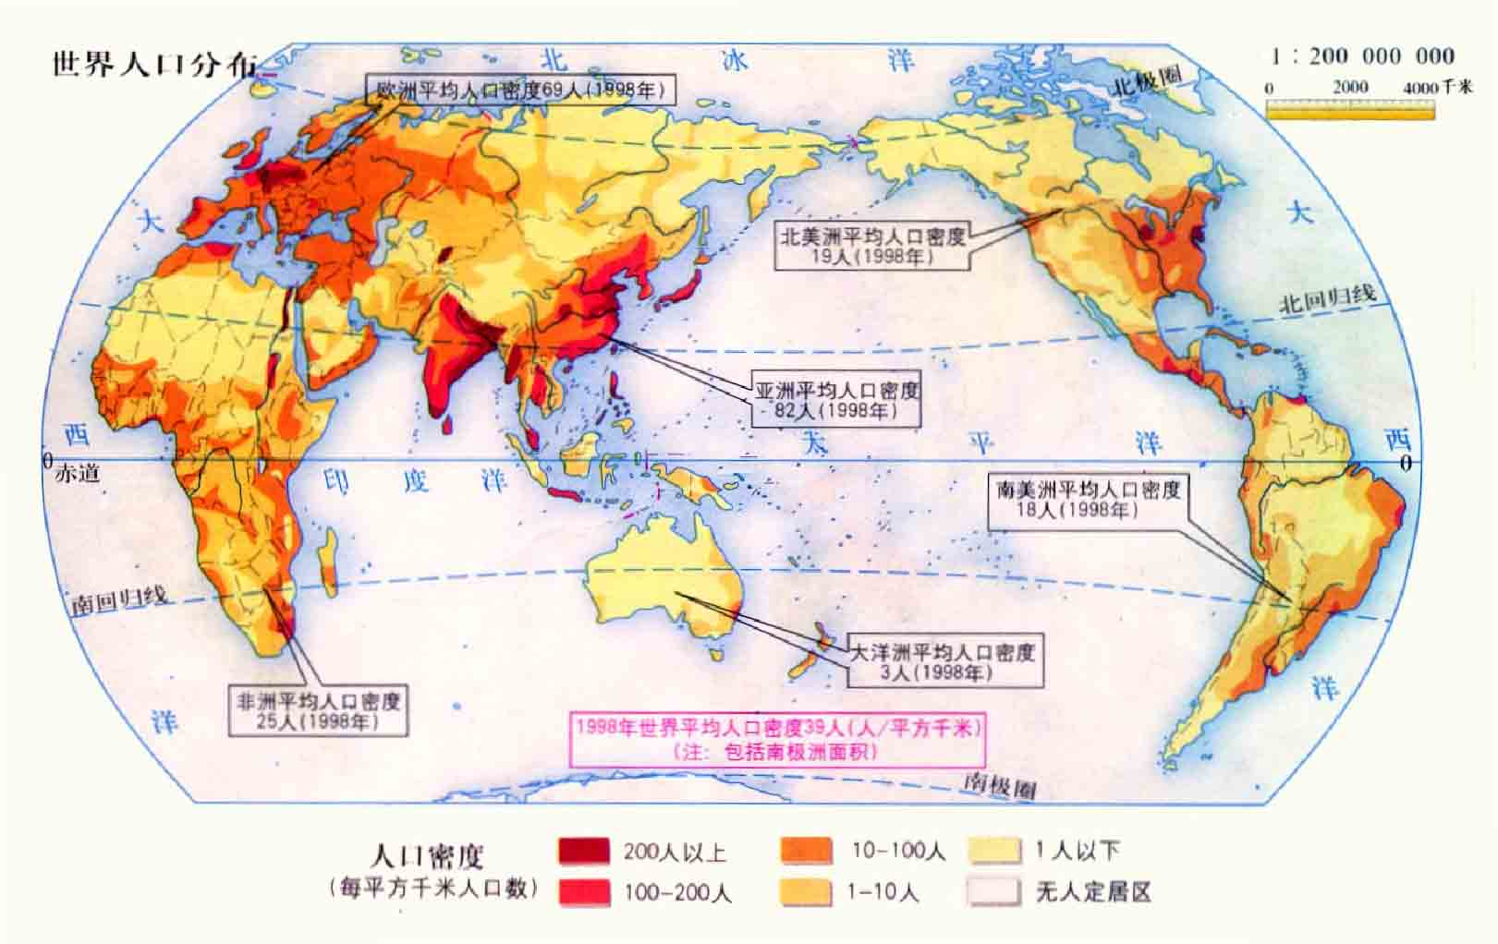

Slide 10

隐私保护
为保持数据记录的敏感性，变换为一个混沌的数据集
以概率密度函数替代原始数据
应用举例：位置业务（LBS）
移动对象的当前位置以及位置变迁信息涉及用户隐私
从物理设备采集的数据再加上一层保护
以区域描述物体位置，隐藏对象的真实位置

Slide 11
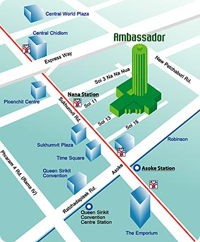

动机: LBS中的隐私问题
去大使馆怎么走？
LBS提供者
去购物中心怎么走？
唯一身份
位置信息

Slide 12
隐私要求
隐私 & QoS 权衡
位置匿名
敏感的位置: 诊所, 夜总会
L包含至少k-1其他用户
身份匿名
敏感消息: 政治性的, 金融性的
l(x,y)包括至少 k-1个其他请求
k-匿名模型
位置点 l(x,y)
r2
r3
r1
覆盖的区域L
r4

Slide 13
应用背景四
缺失值处理
缺失数据是经典的不确定数据的应用
经插值后的缺失数据可以看作服从某个概率分布的随机变量，或者看作是数据具有预先定义好的误差。
一些数据记录通过统计方法得到，比如通过预测和插值得到的数据记录，在这种情况下，推断得到的数据可以被精确地估计。
应用举例
在数据清洗应用中非常常见

Slide 14
空缺值
数据并不是永远有效的
例如，很多记录的许多属性难以获取，比说说在销售数据中客户的收入情况很难掌握。
数据空缺可能是由于
装备的故障
由于和其他数据不一致而被删除了
由于理解错误而未被录入
某些数据在录入的时候并不认为是重要的，因此没录入
……
空缺的数据可能需要被推断出来

Slide 15
如何应对空缺值？
忽略该记录: 当类标号缺少时通常这样做（假定挖掘任务涉及分类或者描述）。除非元组有多个属性缺少值，否则该方法不是很有效。当每个属性缺少值的百分比变化很大时，它的性能非常差。
手动填充空缺值：一般地说，该方法很费时，并且当数据集很大、缺少很多值时，该方法可能行不通。
使用一个全局的常数代表缺失值，例如 “unknown”, 但是这可能会引入一个新类型?!
使用平均值来取代缺失值
使用与给定元组属同一类的所有样本的平均值：例如，若将顾客按credit_risk分类，使用具有相同信用度的顾客的平均收入替换income中的空缺值
使用最可能的值去填充缺失值：例如贝叶斯公式或者决策树

Slide 16

数据集成
相异模式
数据不一致性
应用举例：万维网（Web）
万维网（Web）是Internet上最重要的应用
从海量Web数据中自动抽取重要信息

Slide 17
网页信息抽取的不确定性
抽取条目可能存在错误!
对于各个条目，提供置信分数
以简单的 人名条目 抽取为例
Last evening I met the candidate Shiv
Vaithyanathan for dinner. We had an
interesting conversation and I encourage
you to get an update. His host Bill can be
reached at X-2465.
C = 首字母大写的单词
D = 在人名字典中找得到的单词
信息抽取规则 精度
[CD] [CD] 0.9
[CD] 0.6
抽取的条目 | 概率
Shiv Vaithyanathan | 0.9
Bill | 0.6
[CD] [CD]
[CD]

Slide 18

迫切需要新技术处理这类问题
以经典确定性技术（deterministic technology）解决上述问题？
数据清洗无法有效处理所有类型的不准确数据
例如，RFID数据的不准确性表现为漏读、多读、脏数据等多种情况，分别采用不同方法进行处理，例如建立概率模型、机器学习建模、网络RFID阅读器最优化调度策略等，然而并没有出现能够有效处理所有不准确类型的技术。
因此，迫切发展不确定性数据库管理技术

Slide 19

概率关系数据库
从上世纪80年代后期开始，至今仍在继续
为何现在博得学术界的关注？
应用驱动
多种数据类型，如不匹配数据值、不精确查询、不一致数据、不匹配的模式等。
Xml, 数据流，···
是最主要的驱动力量
技术驱动
处理不确定性数据比处理确定性数据更难
部分现有方法回避了复杂度
研究成果有助于更好地管理概率数据库

Slide 20
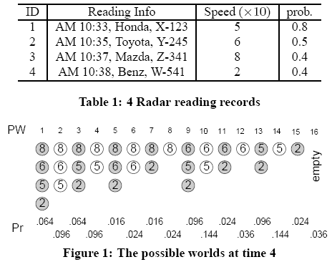
挑战一：庞大的可能世界实例集合
共有2⁴个实例（instance），
每个实例 = 各记录发生或不发生的情况

Slide 21

描述所有实例，在各实例中，各元组出现或不出现
两种不确定性
存在级不确定性（Existential Uncertainty）
描述元组在数据库中的存在性
元组的存在（/不存在）会影响其他元组的存在（/不存在）
元组间存在更复杂的相关性
属性级不确定性（Attributer Level Uncertainty）
元组存在，值不确定
以概率分布函数或者具体概率参数表示
易于处理

Slide 22
可能世界
元组之间存在依赖关系的情况

Slide 23

属性域:
int, char(30), varchar(55), datetime
关系模式:
值域大小: 2³², 2²⁴⁰, 2⁴⁴⁰, 2⁶⁴
Employee(name:varchar(55), dob:datetime, salary:int)
元组域大小: 2⁴⁴⁰ * 2⁶⁴ * 2³²
实例数目: 2^{2440 * 264 * 232}
数据库模式:
Employee(. . .), Projects( . . . ), Groups( . . .), WorksFor( . . .)
实例数目: N (= BIG but finite)

Slide 24
挑战二：新出现的维度（概率维）
概率维无处不在
输入数据可能有概率，表示元组自身或者某字段具有不确定性；
输出结果可能有概率，表明该项结果的发生概率；查询定义可以有概率，用于约束查询结果；
处理过程也与概率紧密相关。
查询定义可能含概率信息。
概率维的引入极大地改变了传统的数据处理模式，迫切需开发新技术进行处理。

Slide 25
二、不确定时空数据库

Slide 26
Uncertainty
An object’s location is described by a probability density function.

Slide 27
Probabilistic range search
Find the clients that are currently in the town center with at least 50% probability.

Slide 28
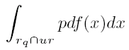
Qualification probability
Qualification probability:
Example: uniform

Slide 29
Review: MBR and why
Minimum bounding rectangle (MBR)

Slide 30
Main Idea
For each object, pre-compute some auxiliary information that can be used to
efficiently decide whether an object appears in a region with at least a certain probability
without calculating its actual appearance probability.
Auxiliary information = Probabilistically constrained rectangle

Slide 31
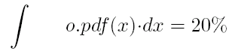
Probabilistically Constrained Rectangle (PCR)

Slide 32
PCR in pruning
Probability threshold t_{q}= 0.8.

Slide 33
PCR in pruning
Probability threshold t_{q}= 0.2.

Slide 34
三、不确定数据集成

Slide 35
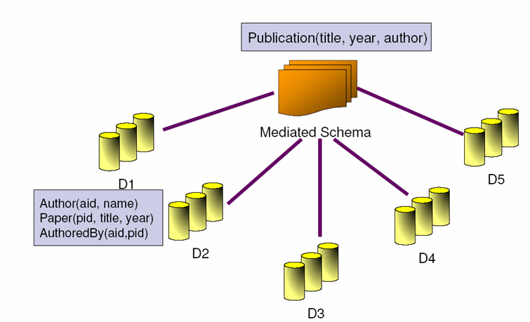
Traditional Data Integration Systems
SELECT P.title AS title, P.year AS year, A.name AS author
FROM Author, Paper, AuthoredBy
WHERE Author.aid = AuthoredBy.aid AND Paper.pid = AUthoredBy.pid
Q
Q₅
Q₁
Q₂
Q₄
Q₃

Slide 36
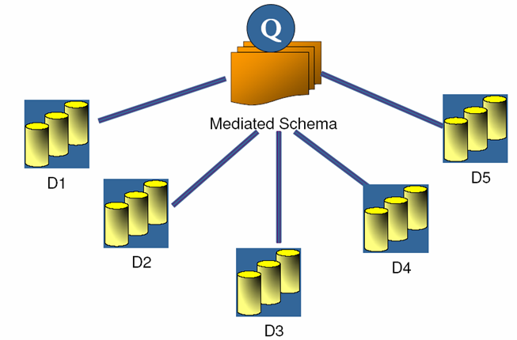
Uncertainty Can Occur at Three Levels in Data Integration Applications
Focus of the paper:
Probabilistic schema mappings
III. Query Level
II. Mapping Level
I. Data Level

Slide 37
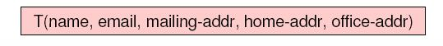
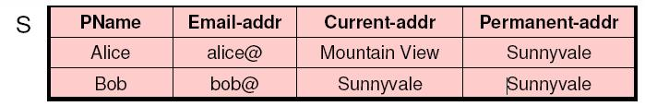
Example Probabilistic Mappings
m1:
T(name, email, mailing-addr, home-addr, office-addr)
0.5
S(pname, email-addr, current-addr, permanent-addr)
m2:
T(name, email, mailing-addr, home-addr, office-addr)
0.4
S(pname, email-addr, current-addr, permanent-addr)
m3:
T(name, email, mailing-addr, home-addr, office-addr)
0.1
S(pname, email-addr, current-addr, permanent-addr)

Slide 38
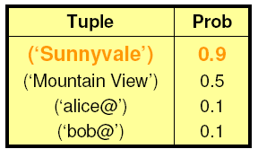
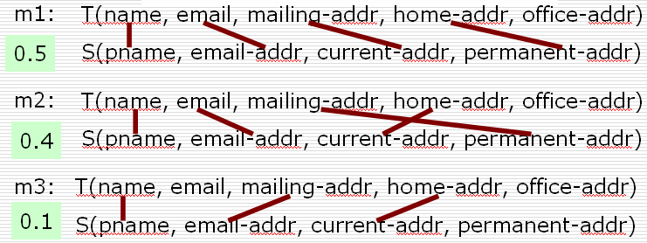

Top-k Query Answering w.r.t. Probabilistic Mappings
Q: SELECT mailing-addr FROM T
Mediated
Schema
Q1: SELECT current-addr FROM S
Q2: SELECT permanent-addr FROM S
Q3: SELECT email-addr FROM S
0.1
0.5
0.4

Slide 39
Definition of probabilistic mappings
Schema Mapping
Probabilistic Mapping
S=(pname, email-addr, home-addr, office-addr)
T=(name, mailing-addr)
one-to-one schema matching
have exact knowledge of mapping
S=(pname, email-addr, home-addr, office-addr)
0.1
0.5
0.4
1.0
T=(name, mailing-addr)

Slide 40
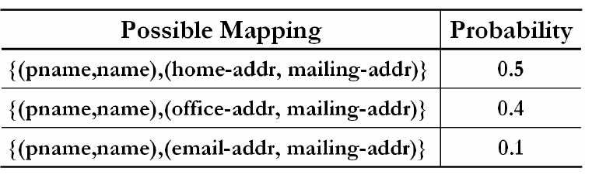
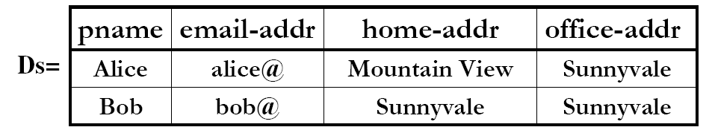
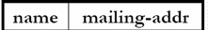
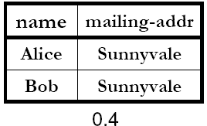
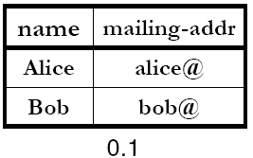
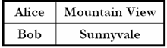
By-Table Semantics
m
DT=
0.5

Slide 41
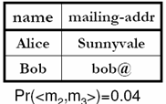
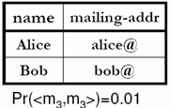
By-Tuple Semantics
…
DT=
Pr(<m1,m3>)=0.05

Slide 42
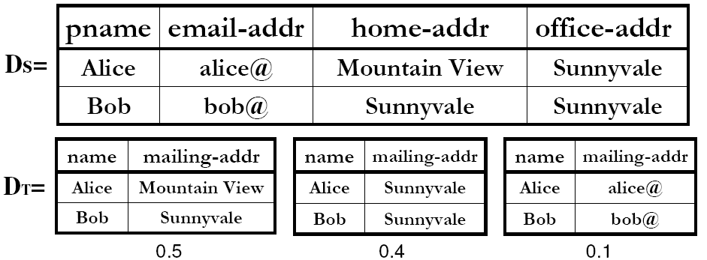
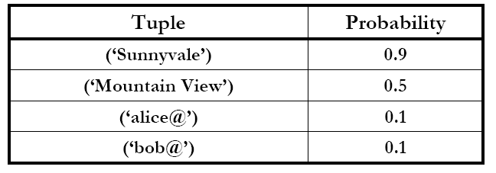
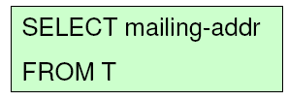
By-Table Query Answering

Slide 43
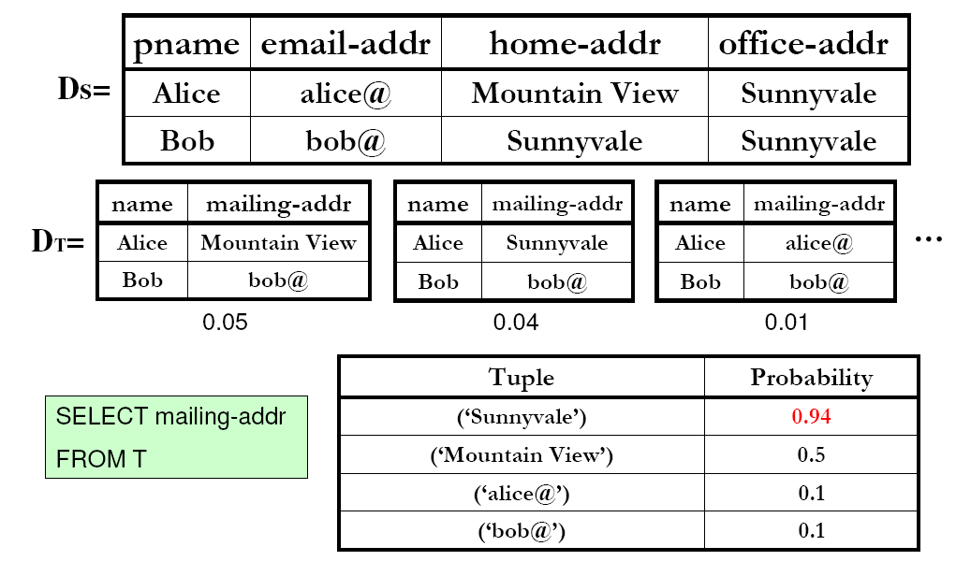
By-Tuple Query Answering

Slide 44
四、不确定数据世系管理

Slide 45
Motivation
Many applications require both lineage and uncertainty.
Data integration
Deduplication
Scientific data management
Information extraction
Lineage is useful since it
Offers helpful additional info to users
Correlates uncertainty in results with base data
Exhibits representl and computl benefits

Slide 46
ULDB Data Model (1)
Database with Lineage (LDB)

Slide 47
ULDB Data Model (2)
x-relation (Uncertain Database)
x-tuples: tuple alternatives
maybe x-tuples: ‘?’

Slide 48
ULDB Data Model (3)
ULDB: Combining Lineage and Uncertainty

Slide 49
五、Ranking查询

Slide 50
Possible World Model
ID | Speed(*10) | Prob.
1 | 5 | 0.8
2 | 6 | 0.5
3 | 8 | 0.4
4 | 2 | 0.4
A small record set
of reading logs
Tuples | Pr. | Tuples | Pr. | Tuples | Pr.
8, 6, 5, 2 | .064 | 8, 6, 5 | .096 | 8, 5, 2 | .064
8, 5 | .096 | 8, 6, 2 | .016 | 8, 6 | .024
8, 2 | .016 | 8 | .024 | 6, 5, 2 | .096
6, 5 | .144 | 6, 2 | .024 | 6 | .036
5, 2 | .096 | 5 | .144 | 2 | .024
Empty | .036
16 possible world
instances
Sliding-window Top-k Queries on Uncertain Streams, VLDB 2008

Slide 51
Uncertain Top-k queries
Sliding-window Top-k Queries on Uncertain Streams, VLDB 2008
U-Topk [4]
returns the top-k tuples in all possible worlds with maximum probability.
U-kRanks [4]
returns the winner for the i-th rank for all 1 ≤ i ≤ k.
PT-k [2]
returns all the tuples with maximum aggregate probability greater than a user-given threshold p
aggregate probability: the prob. of being the top-k among all.
Pk-Topk
returns the k most probable tuples of being the top-k among all.
A slight modification of PT-k, while without threshold p.

Slide 52
Example (k=2)
Tuples | Pr. | Tuples | Pr. | Tuples | Pr.
8, 6, 5, 2 | .064 | 8, 6, 5 | .096 | 8, 5, 2 | .064
8, 5 | .096 | 8, 6, 2 | .016 | 8, 6 | .024
8, 2 | .016 | 8 | .024 | 6, 5, 2 | .096
6, 5 | .144 | 6, 2 | .024 | 6 | .036
5, 2 | .096 | 5 | .144 | 2 | .024
Empty | .036
16 possible world instances
Query results
Query | U-Topk | U-kRanks | PT-k | Pk-Topk (p=0.3)
Result | {6, 5} | {8, 5} | {5, 6, 8} | {5, 6}
Sliding-window Top-k Queries on Uncertain Streams, VLDB 2008

Slide 53
多种语义

Slide 54
六、NN 查询

Slide 55
Computing P_{nn}
y
0.3
0.7
O₂
O₁
x
1.0
P_{nn}表示一个对象成为
最近邻的概率。
q
O₄
0.1
0.9
O₃
Assume Pr(O_{i}) =1.0
P_{nn}(O₁,q | O₁=y ∧ q=x) = 0.7 * 1.0 * 0.9
VLDB 2008
I.F. Ilyas
Notes:
Pnn(O_1,q) = int over O_1 and q

Slide 56
Solution Overview
Avoid expensive nested integration by lazily computing and incrementally tightening bounds on P_{nn}(O_{i},q) (CPU cost)
Use incremental retrieval model to avoid unnecessary objects retrieval (I/O cost)
Interleave computation of P_{nn}(O_{i},q) bounds and objects retrieval (overall cost)
VLDB 2008
I.F. Ilyas

Slide 57
Minimizing IO: MinDist Retrieval
Retrieve objects based on their minimum distance to q (e.g., using R-tree index)
A virtual object φ is used to represent non-retrieved objects
O₁
O₂
O₁
O₂
∞
q
q
φ
φ
O₃
O₃
Calculate lower bound of O_{i}
Calculate upper bound of O_{i}
VLDB 2008
I.F. Ilyas
Notes:
We proved that any other retrieval model would result in trivial lower bound

Slide 58
Minimizing CPU: Computing Bounds
x
0.3
0.7
O₂
0.7
0.2
0.1
O₂
O₁
q
1.0
O₁
q
0.3
0.7
O₄
O₄
0.1
0.9
O₃
0.9
0.1
O₃
P_{nn}(O₁|O₁=x) = (0.7)(1.0)(0.9)
(0.2)(0.7)(0.1) ≤ P_{nn}(O₁)
VLDB 2008
I.F. Ilyas
Notes:
And to get the unconditional pr, we multiply in Pr(O₁)

Slide 59
Minimizing CPU: Computing Bounds
x
0.3
0.7
O₂
0.7
0.2
0.1
O₂
O₁
q
1.0
O₁
q
0.3
0.7
O₄
O₄
0.1
0.9
O₃
0.9
0.1
O₃
P_{nn}(O₁|O₁=x) = (0.7)(1.0)(0.9)
(0.2)(0.7)(0.1) ≤ P_{nn}(O₁) ≤ (0.9)(1.0)(1.0)
VLDB 2008
I.F. Ilyas
Notes:
And to get the unconditional pr, we multiply in Pr(O₁)

Slide 60
Minimizing CPU: Bounds Tightening
The initial partition consists of one subregion
We refine a partition by
Select one subregion
Split the subregion to form two smaller subregions
VLDB 2008
I.F. Ilyas

Slide 61
Minimizing Overall Cost
Select the object with the highest probability upper bound
If it is φ, we retrieve another object
Select a subregion to split using benefit/cost ratio
Benefit is proportional to the difference between bounds
Cost is the weighted sum of:
CPU cost: estimated computation time
I/O cost: only present if we have to retrieve another object
VLDB 2008
I.F. Ilyas

Slide 62
Minimizing Overall Cost
Lower bounds of R₁₄,R₂₃,R₃₂ (outmost subregions) are zero
The only way to tighten these bounds is to retrieve a new object
To tighten a subregion:
If it is an “inner” subregion, we split it at middle
Otherwise, retrieve a new object
VLDB 2008
I.F. Ilyas

Slide 63
Example: Optimizing Overall Cost
Obj | Sub regions |  |  | Bounds
 |  | bounds | rank
O₁ | R₁ | [0,1] | 1 | [0, 1]
Ф |  |  |  | [0, 1]
q
R₁
O₁
VLDB 2008
I.F. Ilyas

Slide 64
Example: Optimizing Overall Cost
Obj | Sub regions |  |  | Bounds
 |  | bounds | rank
O₁ | R₁₂ | [0,0.8] | 0.8/(cpu+IO) | [0.2, 1]
 | R₁₁ | [ 0.2,0.2] | 0
O₂ | R₂ | [0,0.8] | 0.8/(cpu+IO) | [0, 0.8]
Ф |  |  |  | [0, 0.8]
R₂
O₂
q
R₁₁
R₁₂
O₁
VLDB 2008
I.F. Ilyas

Slide 65
Example: Optimizing Overall Cost
Obj | Sub regions |  |  | Bounds
 |  | bounds | rank
O₁ | R₁₂ | [0.18,0.3] | 0.12/cpu | [0.38,0.7]
 | R₁₃ | [0,0.2] | 0.2/(cpu+IO)
 | R₁₁ | [ 0.2,0.2] | 0
O₂ | R₂₁ | [0.18,0.3] | 0.12/cpu | [0.18, 0.4]
 | R₂₂ | [0,0.1] | 0.1/(cpu+IO)
Ф |  |  |  | [0, 0.44]
R₂₂
R₂₁
O₂
q
R₁₁
R₁₂
R₁₃
O₁
R₃
O₃
VLDB 2008
I.F. Ilyas

Slide 66
Example: Optimizing Overall Cost
Obj | Sub regions |  |  | Bounds
 |  | bounds | rank
O₁ | R₁₂₁ | [0.12,0.15] | 0.03/cpu | [0.42, 0.69]
 | R₁₂₂ | [0.1,0.14] | 0.03/cpu
 | R₁₃ | [0,0.2] | 0.2/(cpu+IO)
 | R₁₁ | [ 0.2,0.2] | 0
O₂ | R₂₁ | [0.18,0.3] | 0.12/cpu | [0.18, 0.4]
 | R₂₂ | [0,0.1] | 0.1/(cpu+IO)
Ф |  |  |  | [0, 0.4]
R₂₂
R₂₁
O₂
q
R₁₁
R₁₂
R₁₃
O₁
R₃
O₃
VLDB 2008
I.F. Ilyas

Slide 67
Inversed NN

Slide 68
Top-k Queries
monotonic preference function
f(o) = o.height + o.weight
For newborn babies, large values of weight and height would indicate their good health
Given a monotonic preference function f(.) that outputs the score of a baby, we can rank babies sorted on scores
In literature, the problem of retrieving k babies with the highest scores is called top-k query
DASFAA 2009, Brisbane, Australia
Notes:
Let me first give an example of top-k query.
Assume we have a number of newborn babies. Each baby has his/her own height and weight, which is represented by a point in this data space.
Intuitively, if a baby has large values of weight and height, then it indicates a good health of this baby. The top-k problem would specify a preference function, for example, to compute the summation of weight and height. Then, each baby has a score based on this preference function. In our example, baby a has the largest score, baby b has the second largest score, and so on. The top-k problem is to retrieve k babies who have the scores, that is, k healthiest babies.

Slide 69
Inverse Ranking Queries [Li, 2007]
monotonic preference function
f(o) = o.height + o.weight
For a newborn baby, we may be interested in his/her health compared with other babies, for example, in terms of height and weight
Given a query baby q and a preference function f(.), an inverse ranking problem is to obtain the rank of baby q among other babies, in order to infer q's health
query baby q
DASFAA 2009, Brisbane, Australia
Notes:
In contrast, for the inverse ranking query, instead of finding babies with the highest scores in the existing database, we are given a query baby q, and we want to determine the health of this query baby compared with other babies. In other words, we want to obtain the rank of this query baby in this database. In this example, we can see that the rank of this query baby is 3.

Slide 70
Inverse Ranking Queries (cont'd)
monotonic preference function
f(o) = o.credit + o.salary
Credit Card Application
The information of customers includes the credit history and salary
To determine the credit line of a new customer among his/her peers
query customer q
DASFAA 2009, Brisbane, Australia
Notes:
The inverse ranking query has many other applications, for example, in the credit card application. Each customer has his/her information including the credit history and salary. Similarly, assume we have a preference function which sums up credit and salary of each customer.
Now given a new customer q, the credit card company may want to determine the credit line of this customer by comparing his/her score with those of other customers.

Slide 71
Inverse Ranking Queries over Uncertain Data
For the sake of privacy preserving, the information of newborn babies in the hospital is generalized by replacing exact values with uncertain intervals, before the public release
uncertainty region
query baby q
DASFAA 2009, Brisbane, Australia
Notes:
In the previous example of newborn babies, the information of babies are usually confidential. Therefore, for the sake of privacy preserving, before the public release, data are often generalized to uncertainty regions. That is, the actual data can reside anywhere within the region.
In this case, it is not trivial to answer an inverse ranking query due to the data uncertainty. For example, the rank of query object q here can be 2, 3, or 4.

Slide 72
Inverse Ranking Queries over Uncertain Data (cont'd)
Credit Card Application
The public profiles of customers may be disturbed by injecting noises for privacy preserving purposes
Conduct inverse ranking queries on uncertain data
We want to answer the inverse ranking query over uncertain data efficiently and effectively
query customer q
DASFAA 2009, Brisbane, Australia
Notes:
Similarly, in the application of credit card, the data of customers can be also uncertain due to the injection of noises for the privacy preserving purposes. We want conduct the inverse ranking query over such kind of data efficiently and effectively.

Slide 73
Challenges of Uncertain Query Processing
Challenges
Effectiveness
We need to provide the confidence guarantee of query answers on uncertain data
Efficiency
We have to design effective pruning methods to reduce the search space
DASFAA 2009, Brisbane, Australia
Notes:
With this uncertainty model, uncertain query processing has two major challenges. One is effectiveness, that is, we need to provide the confidence guarantee of query answers on uncertain data. The other challenge is the efficiency, that is, we need to design effective pruning methods to reduce the search space, and efficiently answer queries.

Slide 74
Problem Definition –Inverse Ranking Queries [Li, 2007]
Inverse Ranking Queries in "Certain" Databases
A certain database, D
A query object, q
A monotonic preference function, f(·)
An inverse ranking query computes the rank, k, of the query object q in the database D
DASFAA 2009, Brisbane, Australia
Notes:
Now, we first give the definition of inverse ranking query on precise data.
Given a certain database containing precise data, a query object q, and a monotonic preference function f, an inverse ranking query is to compute the rank of query object q in a database.

Slide 75
Problem Definition – Probabilistic Inverse Ranking Queries
Probabilistic Inverse Ranking Queries in Uncertain Databases
An uncertain database, D^{U}
A query object, q
A probability threshold, α ∈ [0, 1)
A monotonic preference function, f(·)
A probabilistic inverse ranking (PIR) query computes all the possible ranks, k ∈ [1, N +1], of the query object q in the database D^{U} each with probability, Pr_{k-PIR}(q, f(.)), greater than α, where:
DASFAA 2009, Brisbane, Australia
Notes:
In our problem, we consider the inverse ranking query on uncertain data, that is, probabilistic inverse ranking query.
Given an uncertain database, a query object q, probabilistic threshold alpha, and a preference function f(), a probabilistic inverse ranking query, or PIR query, is to compute all the possible ranks of query object q in this uncertain database with probabilities greater than alpha.
This probably that query object q has the k-th rank can be given by this complex formula. Intuitively, if q has the k-th rank, then there exists (k-1) objects which have scores greater than that of q, and the remaining objects have scores lower that of q.

Slide 76
PIR Example
PIR answer (α = 0.5)
When k = 1, Pr_{1-PIR}(q, f(⋅))=0;
When k = 2, Pr_{2-PIR}(q, f(⋅))=0.2;
When k = 3, Pr_{3-PIR}(q, f(⋅))=0.7;
When k = 4, Pr_{4-PIR}(q, f(⋅))=0.1;
When k = 5, Pr_{4-PIR}(q, f(⋅))=0;
… …
Reduce the PIR Search Space!
O(N)
query baby q
Linear Scan Method
Sequentially scan the entire database
Compute the PIR probability, Pr_{k-PIR}(q, f(⋅)), of query object q for each possible rank k
monotonic preference function
f(o) = o.height + o.weight
DASFAA 2009, Brisbane, Australia
Notes:
Here is the previous example of PIR query. One straightforward way to answer PIR queries is the linear scan method. That is, we sequentially scan all the objects in the database, and then for each possible rank, such as rank 1, 2, 3, and so on, we compute its PIR probability.
In our example, when k=1, the PIR probability is 0. This is because q can never have the highest score, due to the existence of baby a. Similarly, we can compute the probability that q has the second rank, which is equal to 0.2, and so on. If the threshold alpha is 0.5, then rank 3 will be returned as the our PIR answer, since its PIR probability 0.7 is above 0.5.
From this example, we can see that the linear scan needs O(N) retrieval cost, where N is the database size. Moreover, the computation of PIR probability is also very costly involving all objects in the database. Therefore, the linear can is not efficient, and this is the reason that we aim to reduce the PIR search space in our work.

Slide 77
Reducing the Search Space
R⁺
Classify uncertain objects into 3 categories
R⁺ – a set of objects o with scores f(o) definitely larger than f(q)
R₀ – a set of objects o that might have scores f(o) equal to f(q)
R⁻ – a set of objects o with scores f(o) definitely smaller than f(q)
R₀
query point q
R⁻
DASFAA 2009, Brisbane, Australia
Notes:
To achieve this goal, in our work, we classify uncertain objects in the database into 3 categories.
1. The first category is a set of objects having scores definitely larger than that of query point q
2. The second category is a set of objects that might have scores equal to that q
3. Finally, the remaining objects form the third category, which contains objects having scores definitely smaller than that of q
From the right figure, we can see that due to the existence of o1 in the first category, query point q cannot have the first rank. Similarly, due to the existence of objects in the third category, query point q cannot have ranks 5, 6, or 7. In other words, the only possible ranks of q are from 2 to 4.

Slide 78
Reducing the Search Space (cont'd)
R⁺
Equivalent PIR Query
Let k_{min} = |R⁺| +1 and k_{max} = |R⁺| + |R₀| + 1
A PIR query retrieves all the possible ranks, k ∈ [k_{min}, k_{max}], of the query object q, such that:
R₀
query point q
R⁻
DASFAA 2009, Brisbane, Australia
Notes:
Observing this, we can rewrite the PIR probability as a new formula, in which we only need to access those objects in the second category, rather than the entire database. Here, k in the PIR probably is between kmin and kmax, which are the minimum and maximum possible ranks of q, respectively

Slide 79
Reducing the Search Space (cont'd)
R⁺
Indexing
Aggregate R-tree (aR-tree)
Aggregate: COUNT
While traversing aR-tree
Obtain the size, |R⁺|, of set R⁺
Retrieve all the uncertain objects in the set R₀
R₀
query point q
R⁻
DASFAA 2009, Brisbane, Australia
Notes:
In order to facilitate accessing objects in the second category, we construct an aggregate R-tree over uncertain data
That is, we insert the uncertainty region of each uncertain object into the aR-tree using the standard insert operator of aR-tree. The aggregates stored in the aR-tree are the count of objects under this node. For example, node N3 contains 2 uncertain objects, so the count aggregate is 2. Similarly, node N4 contains 3 objects with count aggregate 3. While,traversing the aR-tree, the count aggregates in nodes of aR-tree can help obtain the number of objects in the first category, and aR-tree index can facilitate retrieving objects in the second category.

Slide 80
Pruning Heuristics
R⁺
Upper-Bound Pruning
Obtain an upper bound, UB_Pr_{k-PIR}(q, f(·)), of PIR probability Pr_{k-PIR}(q, f(·)) with a low cost
If UB_Pr_{k-PIR}(q, f(·)) ≤ α, then candidate rank k can be safely pruned
R₀
query point q
R⁻
DASFAA 2009, Brisbane, Australia
Notes:
After the index traversal, we can obtain a number of candidate ranks, as well relevant objects in the second category. However, to compute PIR probability, the cost is still very high. Therefore, our basic idea is to further prune the search space via the upper bound of PIR probability.
That is, assuming we can obtain an upper bound of PIR probability at a low cost, if this upper bound probability is smaller than or equal to alpha, then this candidate rank can be safely pruned

Slide 81
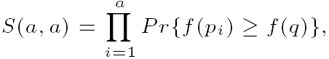
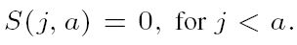
Pruning Heuristics (cont'd)
obtain the upper bound
How to obtain probability upper bound UB_Pr_{k-PIR}(q, f(·))?
Rewrite the PIR probability as a recursive function
where S(j, a) is the probability that the first j objects p_{j} in R₀ has a objects with scores higher than q, given by:
obtain the upper/lower bounds of Pr{f(p_{j}) ≤ f(q)}
obtain the upper/lower bounds of S(., .)
DASFAA 2009, Brisbane, Australia
Notes:
Now we illustrate how to obtain this probability upper bound.
Specifically, we can rewrite the PIR probability as a recursive function S(j, a). Here, j is the number of objects we have seen so far, and a is the number of objects (among j objects) having scores higher than query point q.
The function S() can be given by this recursive function. As a result, in order to obtain the upper bound of PIR probability, we only need to obtain upper/lower bound of recursive function S(). In turn, we only need to obtain the upper/lower bounds of the probability that object p_{j} has score smaller than q

Slide 82
Pruning Heuristics (cont'd)
How to obtain bounds of probability Pr{f(p_{j}) ≤ f(q)}?
Pre-compute probability bounds of Pr{f(p_{j}) ≤ f(s_{i})} with respect to some points s_{i} in UR(p_{j})
Lower bound: the probability that p_{j} is in Region III
Upper bound: the probability that p_{j} is in Region (II ∪ III ∪ IV)
arbitrary
monotonic function
upper bound
lower bound
DASFAA 2009, Brisbane, Australia
Notes:
In order to obtain this probability bounds, we proposed a pre-computation approach.
In particular, within the uncertainty region of each uncertain object, we can randomly pre-select some points, say s1. With respect to s1, we have 4 quadrants I, II, III, and IV. We can prove that, for any monotonic function f(), the probability that object p_{j} has score lower than s1 is lower-bounded by the probability that p_{j} is in Region III, and upper-bounded by the probability that p_{j} is in regions II, III, or IV.
Now we explain how to compute the probability bounds with respect to query point q. By the pre-computation, we can obtain two pre-selected points s1 and s2 whose scores tightly bound the score of q. Then, the probability that pj has score lower than q is lower bounded by the probability pj is in this region, and upper bounded by the probability that pj is in this red region.
This way, we can compute the lower and upper bounds of probability Pr{f(pj)<=f(q)} which can enable the upper-bound pruning method.
Note: the number of pre-selected points is set to 15 in the experiments

Slide 83
Framework for PIR Query Processing
Build an aR-tree index over uncertain objects
For each PIR query
Traverse the aR-tree and retrieve objects relevant to PIR
Filter out false alarms in the set of candidate ranks
Refine the remaining candidates and return actual PIR answers
indexing phase
retrieval phase
pruning phase
refinement phase
DASFAA 2009, Brisbane, Australia
Notes:
We summarize our PIR query processing in this framework.
We build an aR-tree index over the uncertain objects in the indexing phase.
Then, for each PIR query, we traverse the aR-tree and retrieve those objects relevant to our PIR query, which is the retrieval phase.
After the index traversal, we further filter out false alarms of candidate ranks by applying the upper-bound pruning method, which is the pruning phase.
Finally, we refine the remaining candidate ranks by calculating the actual PIR probability via the recursive function S() mentioned earlier, which is the refinement phase.

Slide 84
八、skyline

Slide 85
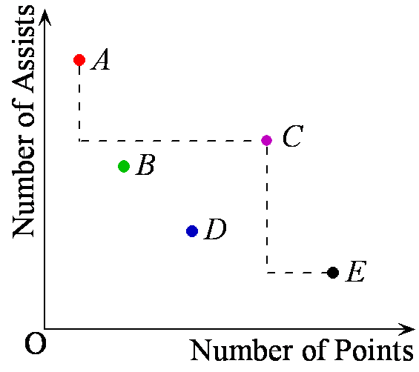
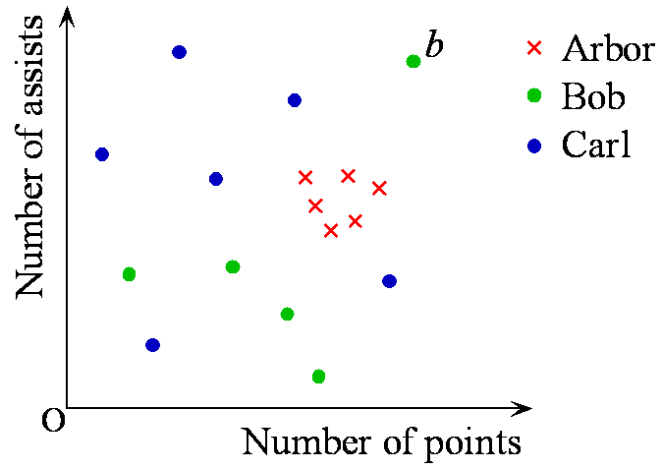
Probabilistic Skylines
[VLDB 2007]
The 33rd International Conference on Very Large Data Bases (VLDB), Vienna, Austria, September 23-28 2007

Slide 86
Probabilistic Skyline
An object is represented by a number of instances
An instance has a probability to represent the corresponding object
An object has a probability to be in the skyline

Slide 87
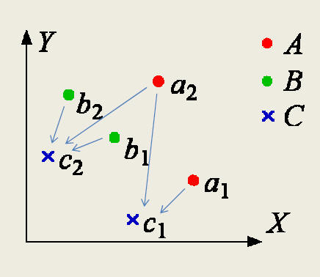
Probabilistic Skyline
Example
A set of object S = {A, B, C}
Each instance takes
equal probability (0.5) to appear
Probabilistic Dominance
Pr(A ≻ C) = ¾
Pr(B ≻ C) = 1/2
Pr((A ≻ C) ∨ (B ≻ C)) = 1
Pr(C is in the skyline) ≠ (1 - Pr(A ≻ C)) × (1 - Pr(B ≻ C))
Probabilistic dominance ≠ >Probabilistic skyline

Slide 88
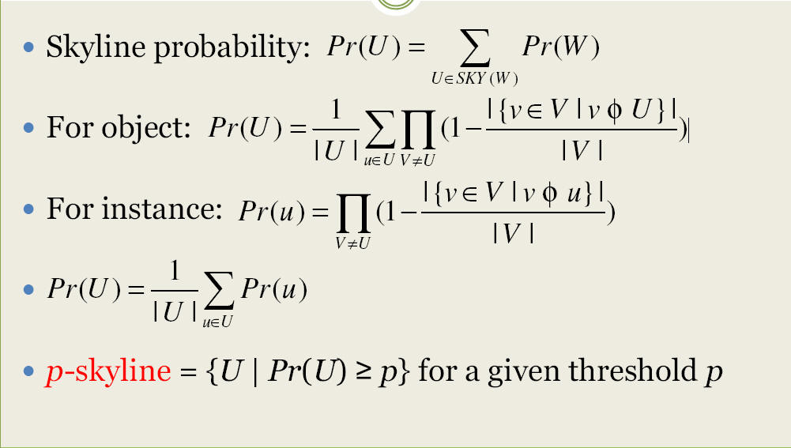
Problem Statement

Slide 89
Probabilistic Skyline Computation
Iteration: Bounding-Pruning-Refining
Bounding
Compute the upper bound (UB) and lower bound (LB) of the object’s probability
Pruning
If the UB< threshold or LB>threshold, then done; Otherwise,
Refine the UB and LB and do again

Slide 90
九、未来工作

Slide 91
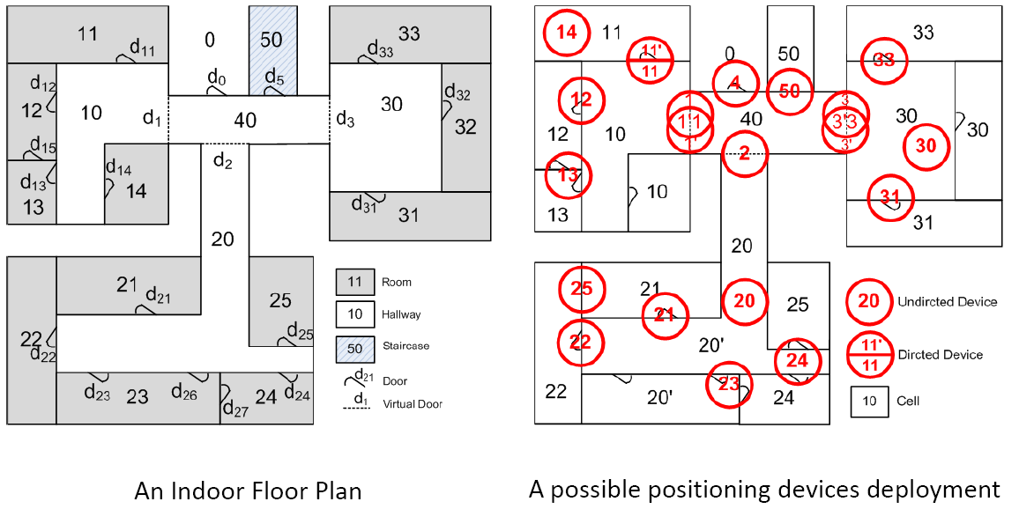
1. Indoor tracking

Slide 92
2. 可能世界模型的应用
TID | A | B | C
T1 | a1 | b1 | 100
T2 | a1 | b2 | 450
T3 | a2 | b2 | 30
T4 | a2 | b2 | 15
T5 | a2 | b2 | 45
分类值 | 属性C的可能取值 | AVG(C)
a1 | {450, 100} | 275
b2 | {450, 30, 15, 45} | 135
b1 | {100} | 100
a2 | {30, 15, 45} | 30
均值
数据样本集合
可能世界模型方法
可能世界实例W | Top-2 | Pr(W)
(at1,450)(at2100) (at3,30)(at4,450) | a1,b2,b1 | 1/2*1/3*1/4*1=1/24
(at1,100)(at2,100) (at3,30)(at4,450) | b2,a1,b1 | 1/2*1/3*1/4*1=1/24
… | … | …

Slide 93
3. 集合的Similarity
Sim (S,T) = |S∩T|/|S∪T| = Jaccard similarity
Example: similarity of sets {1, 2, 3} and {1, 3, 4, 5} is 2/5.
How about probabilistic dataset?
Set A: {<(1, 0.4), (2, 0.4)>, <(9, 0.6, 6, 0.3)>} Set B: {<(1, 0.5), (3, 0.4)>, <(5, 0.7), (6, 0.2)>}
综合考虑在各个可能世界实例中的similarity
难点：可能世界实例的数目极多。

Slide 94
4. skyline
目标：降低通讯传输量
Skyline points:
Skyline points:

Slide 95
5. top-k
目前相关工作非常多。
现有的语义是否充分？
是否可以适用streaming model等模型？
考虑变种查询，例如NN, Reversed NN, Inversed rank等

Slide 96
结束

